Slide 1
DATA STRUCTURES
Alex Zakas

Slide 2

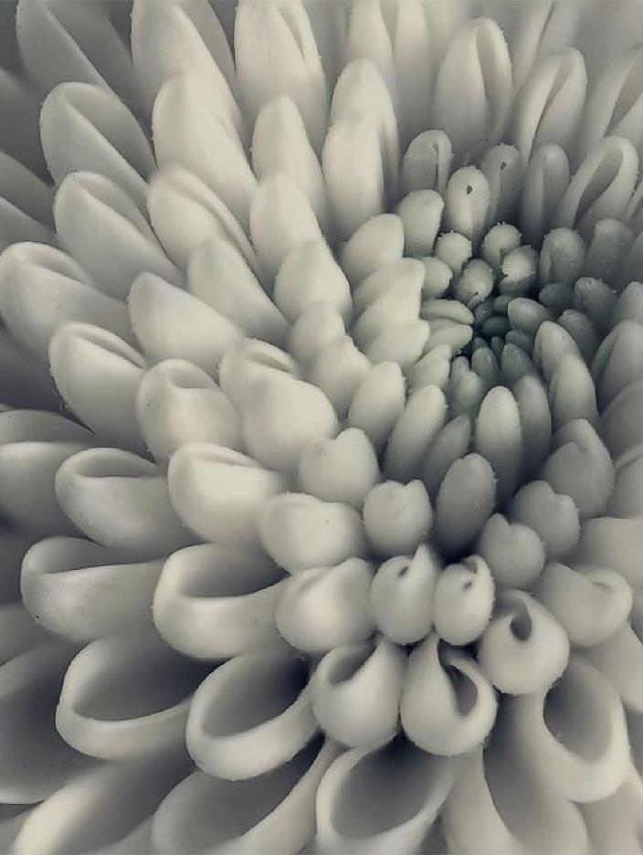
Definition of the problem
The second given assignment on this subject focuses more on graphs and trees depending on the chosen problem. Each one provides different practice methods to be solved and only one can be selected. The description of the first problem depicts a series of wireless sensors inside a network with some acting as senders, receivers and some doing both at the same time. The task asks to find if possible, from a given sensor to send data to another sensor.

Slide 3

Introduction
This type of exercise requires critical thinking as well as problem-solving mindset to create a search algorithm. In theoretical computing, a search algorithm is an algorithm for finding an object with specific properties among a collection of objects like the other end of the sensors. Objects can either be individually stored as data in a data structure, or they can be elements of a search space defined by a mathematical expression or process, such as the roots of an equation with integer variables, or a combination of the two, such as Hamilton circles of a graph. For this assessment, there are not going to be any of those complex algorithms due to the nature of the problem

Slide 4
Solution

Slide 5
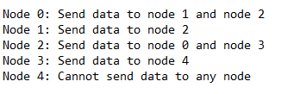
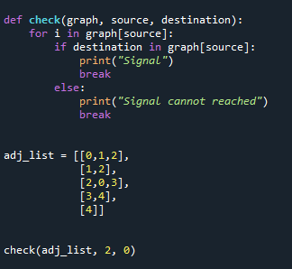
First there is a need for understanding the image of the network in order to proceed with a solution. The image provided was this:
Which first led me to believe that it was a tree, but since one node is connected to multiple others and it’s supposed to be a network, I quickly changed my mind. Second, I created a list of lists, which contained every relative of every node, then I created a function with three parameters, the graph the starting node and the point we want to reach. We check the starting node is able to send data to the destination and prints a message accordingly.
This idea came from the Depth First Search Algorithm, (DFS Algorithm) which performs a brute-force search that begins with the extension of the first child node of the search tree that appears and continues deep into the tree until the requested node is found or until it reaches a node that has no children. The search then continues to the most recent unexplored node. In a non-retrospective implementation, all new unexplored nodes are placed at the top of a stack and the search continues with one of them. Of course, this algorithm is used mostly for tree searches but with the right twist and a simple network like that we are working there can be a proper solution. The point of reference I took for the implementation is a class exercise provided with a request to find all unvisited nodes.

Slide 6



Conclution
By describing the concept of the algorithm as a step-by-step process of problem-solving arises two immediate questions. The first relates to the ability to compare relative returns of different algorithms that solve the same problem, while the second is related to the ability to know if a problem is inherently more difficult to solve than what we thought. Although I’m confident to the solution of this project there will always be another more proper with more clear steps.

Slide 7
Thank you
Alex Zakas
Az101952
azaka@nyc.gr

